Slide 1
Storytelling and the Future
Patricia Riley, PhD
Director, USC Annenberg Scenario Lab
Annenberg School, University of Southern California

Slide 2
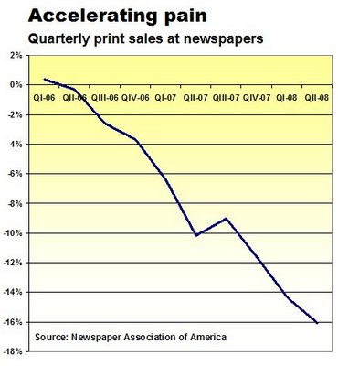
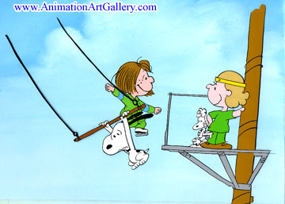
Narrative Arc of the Lab
Starts with a Story Ends with a Story
Lots of Fast Action Scenes

Slide 4
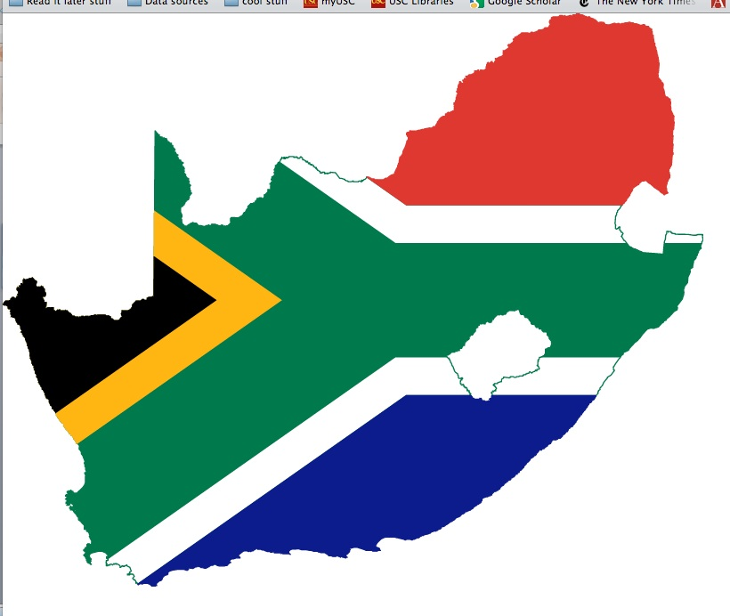
M
Politics

Slide 5
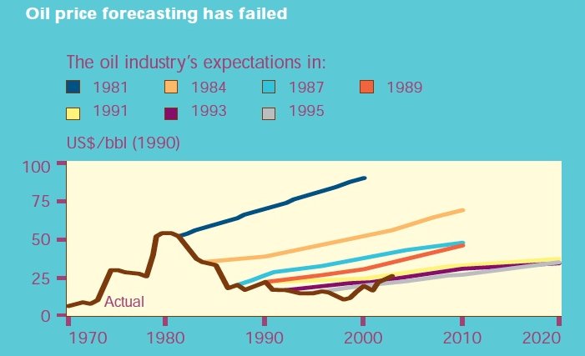
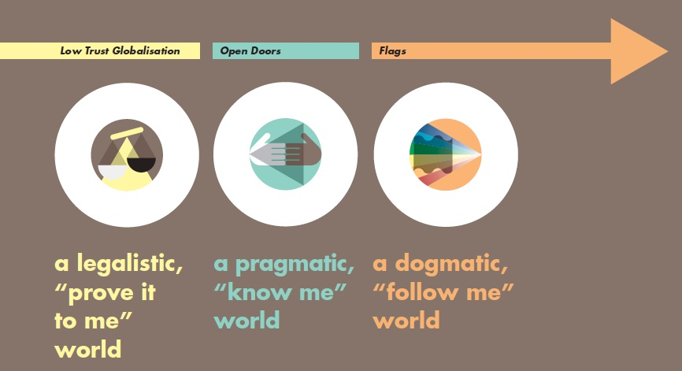
M
Energy

Slide 6
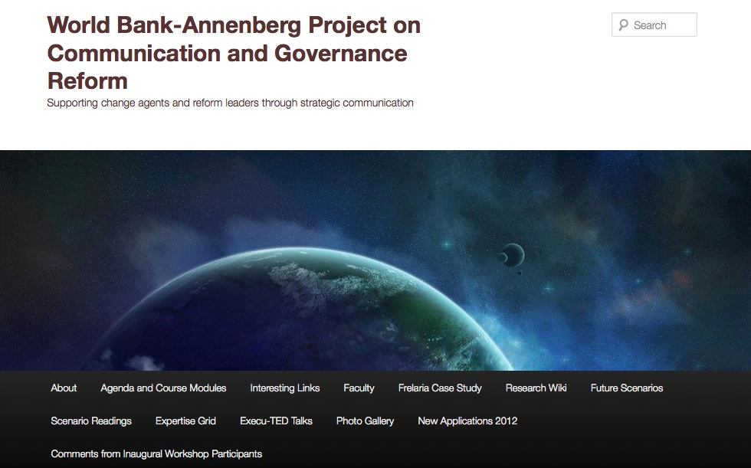
M
USC Annenberg Scenario Lab

Slide 8
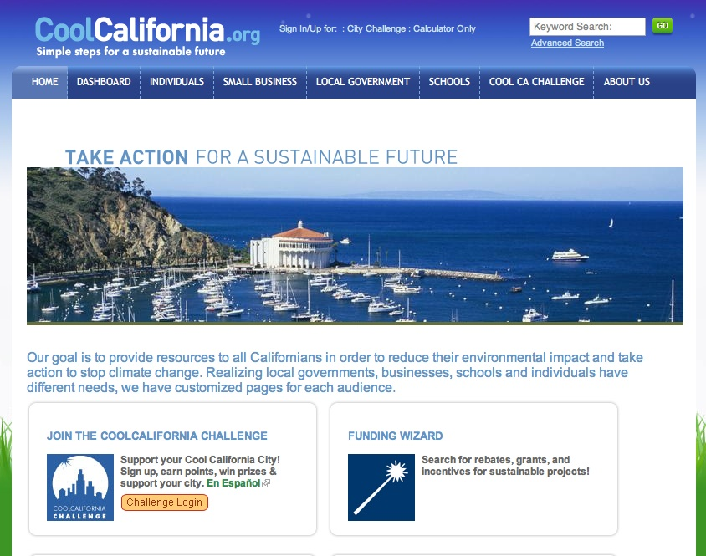
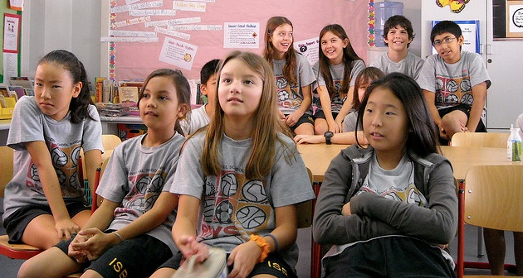
Screen Shot 2013-04-25 at 7.38.55 PM
Screen Shot 2013-04-25 at 7.38.55 PM
http://www.flickr.com/photos/superkimbo/3121817819/

Slide 9
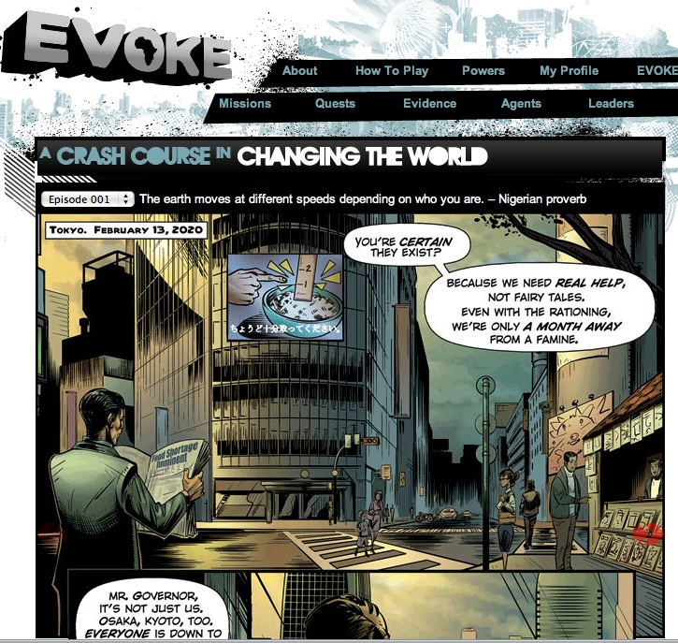
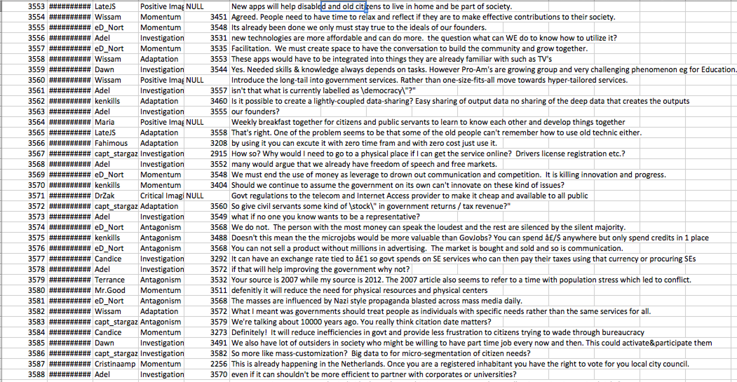
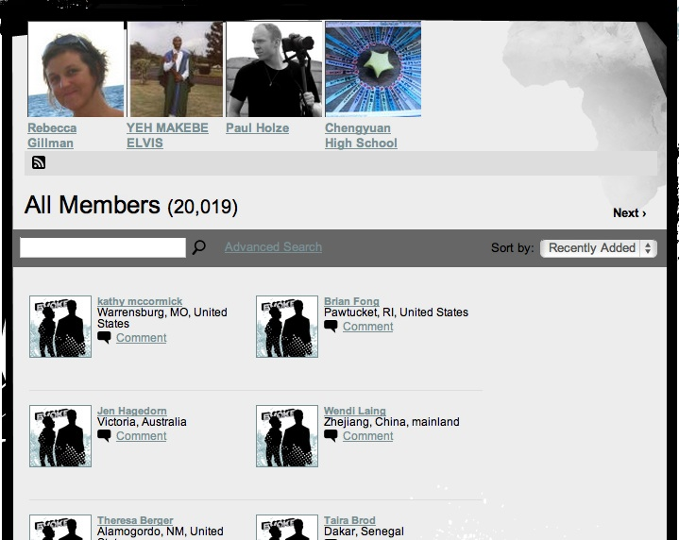

Slide 10
All researchers learn: We always see what we are already looking for, and see what we know!

Slide 11
So how do we get people to focus on what is not known?

Slide 12
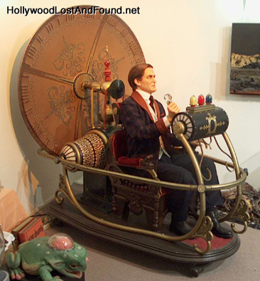
They Have to Imagine
The
Future

Slide 13
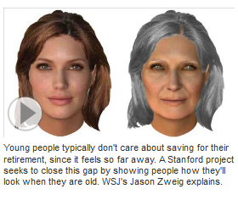
Imagining the Future is Really Hard
Stanford project allows young folks to see themselves at 68
Impact of bad habits?
Save for retirement?
Without foresight the answer is:
“My future self will deal with that.”
No easier in organizations!

Slide 14
If You Want People to Behave Differently:
They have to KNOW why
They have to FEEL why
They have to REMEMBER why
For the majority of folks, stories accomplish this better than data

Slide 15
Have to Develop Your
STORY

Slide 16
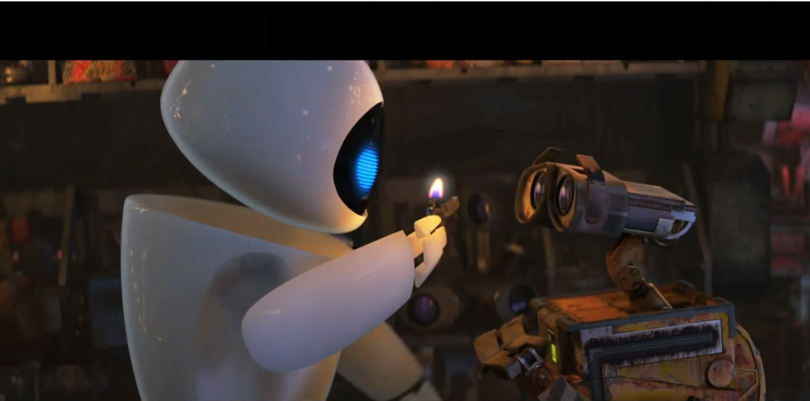
Robots Set the Mood

Slide 17
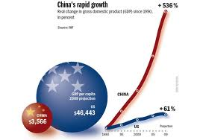
Set the Scene: It is 2017!
There are approximately 7,500,00 people on the planet
Everyone in the developed world 20 or under is a digital native
Games and electronics are all made with Natural User Interfaces—no more remotes
Over 100 billion devices are connected to the Internet
China’ s economy will grow to $5,000,000,000—in about four more years it will surpass the US

Slide 18
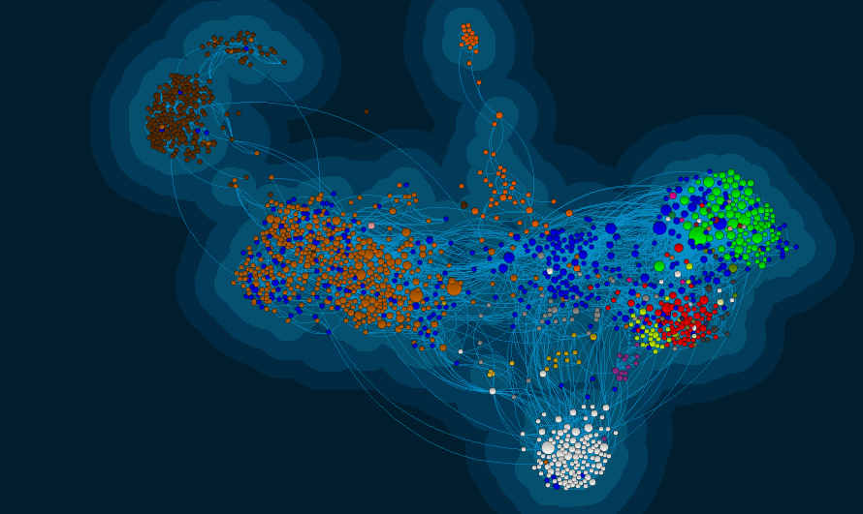
In 2017, it is about Connections

Slide 19
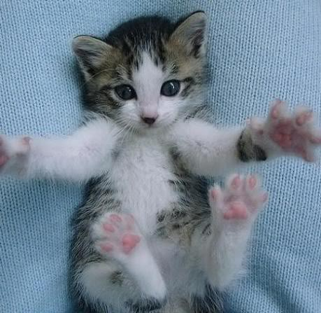
As the Population Ages, Cat and Kitten Videos Are the Largest Category on YouTube
See Catvertising.com

Slide 20
Research on Narratives
People reason through stories—the narrative paradigm (Walter Fisher)
People are storytelling creatures--hardwired
Stories can both illuminate and obscure facts
Stories are judged on their:
Fidelity—Does the story sound true given my life experiences?
Coherence—Does the narrative hang together? Do the people in the story behave in ways that make sense?
Apple vs Microsoft—competing strategies,

Slide 21
The Time Machine: Three Story Types
Culture narratives: identify emerging key values and moments of truth in the organization’s history
Strategy narratives: Capture actions that will create the next chapter in the organization’s history
Future scenarios: Alternative narratives of how the organization “could be” in different but plausible future environments

Slide 22
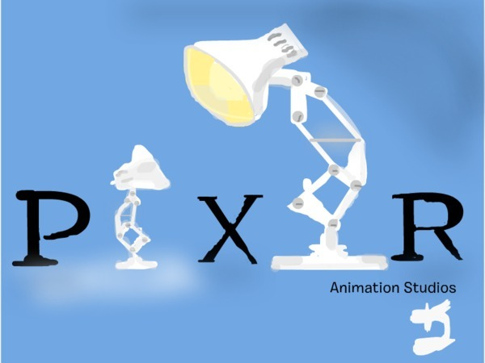
A Great Story is:
A Promise
People have to work to get it or it won’t be interesting
Incomplete
Motivational
Crafted
2+2 = ?

Slide 23
When Telling Your Story: Think Like a Movie Director
Compelling narratives embody plot (action agenda), characters with a motive (inventors, leaders, coalitions), and surprise (emotions)
Helps to have great audio and visuals
People often have to learn how to tell great stories
Modified for stakeholders
Honed in interaction
Rehearsed

Slide 24
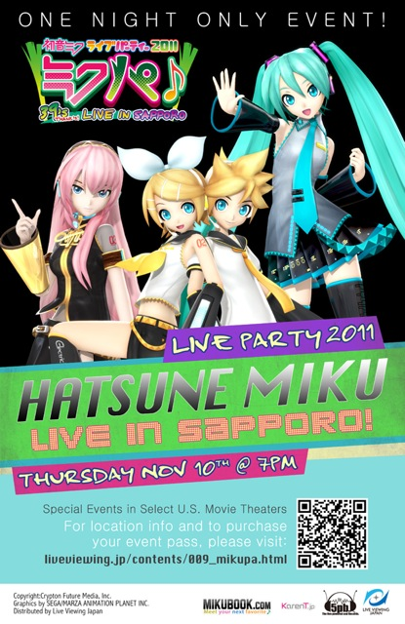
Tests of Culture Stories
Narrative fidelity – does this story seem internally consistent?
Narrative probability – does this story seem likely based on our experience with other similar stories we accept as true?
Characterological coherence – do the actors in the story behave as expected?

Slide 25
CREATIVITY=MEMORABILITY
You have to be “schizophrenic,” in a sense. So you are disciplined, constrained, or “cool” and also extravagant and wild.
Donald J. Cram, Nobel Laureate
University of California, Los Angeles

Slide 26
Stories about Strategy
NPR’s new story is about serving the public wherever they are and however they want to get their news
IBM’s future was about an increasingly complex world with problems only they would be able to solve
Newscorp’s story is about being scrappy, aggressive and risk-taking from Avatar to the WSJ
Tell your story in scenes
The Vision is actually the first scene where the story is new and different
The second scene is often a contest of competing frames that define the tough, needed changes
Who will win? And Why?
Usually the story that gets the early wins.
The third scene is about aligning goals—is the line of sight to the Vision is clear?

Slide 27
REAL WORLD
KEY:
Opportunity
Not Really Social
Idea
High Impact
Low LOE
Current
Listening
Clubs
NPR
Tours
Public Media
Camp
Facebook Fan Pages
& Fan Pages’
Programs
PROMOTION
Live Chats
Social
Bridging
--Across
Site
Station Networks
PARTICIPATION/
ENGAGEMENT
Wait,
Wait …
News-
letters
Email a
Friend
Networks/
Hubs of
Influence
Recruitment
Donations
Real World
Gatherings
NPR AS LIFESTYLE
Crisis Camp
DISTRIBUTION
USER
DIST.
Professional
Dev / Best
Practices
Political
Gambling
Alerts,
Notifica-
tions
Twitter &
Stumbleupon
Sharing Tools
Email, Fb, T
Groups
NPR Spotlights
People to
Follow/Watch
iTunes/
Podcasts
USER-
GENERATED
CONTENT
NPR
Personals
Yahoo!
News
& Buzz
Social
Rec.s
Polls
Widgets: Google
Chrome/iGoogle
Voting on lists (music); All
Songs, 50 voices
(
RSS
YouTube
Direct
Story
Comments
Mashups
(Content)
Reputation
Management
NPR Host
Pers. Brand
COLLABORATIVE
CREATION
ROLES &
GOALS
Metrics
Quizzes
Flickr
Channels
Mobile
Citizen
Reuse Policy
Ombudsman
Blogs
Open Source Code
User
Analytics/
Mkt. Seg.
Playlist
Sharing
NPR
Critics
Vote Report
Projects
COLLABORATIVE
JOURNALISM
Social Gaming
Wait, Wait?
Social Media
Monitoring
“Fan
Dubs”
Customer
Service
Commentaries
Source Gen:
Collab. Story Dev
Wiki
Projects
Crowd-
Sourcing
Product
Feedback
iPhone
App Store
Comments
NPR
Addict
Data Processing/
Analysis
Facebook
Connect
Identity
Management
REGISTRATION/USER IDENTITY
Registration(Tool)
Transparency
Privacy Policy
Authentication

Slide 28
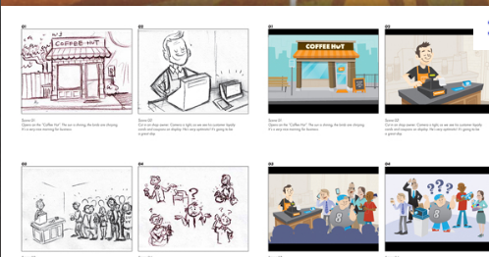
The key is “integrated storytelling!”
Storyboard the Overarching Theme
Stakeholder Analysis
Multiple platforms
All media
Key leader stories
Great attention to detail
Words matter

Slide 29
You are always managing everyone’s partial attention—watch people on the street!
Create your organization’s story with the help of as many employees as you can engage—need a “sandbox”
There will be many stories if you are successful—not like the one story of “the corner grocer”
Test Global power—how does the story “travel?”
Avoid cross-cultural debacles—test and listen

Slide 30
Incorporate New Skills in Your Story of the Future
BIG DATA
Adapted from IFT, Johansen, 2010

Slide 31
What are your enduring values and how do those relate to the values you need for success in 2025 and beyond?
Ambitious
Innovative
Caring
Tech Savvy
Need a Bridge

Slide 32
Other Lessons Learned
Making sense of multiple futures is hard
Storytelling skills are critical
Short-term approach creates blind spots in foresight
Need to set a date that is far enough in the future to allow people to break free of present roles and structures
Having the scenarios be open to all participants seems to encourage more detailed stories of the future
People will change their perspectives
Tendency for positive local stories and pessimistic stories in larger institutions or networks

Slide 33
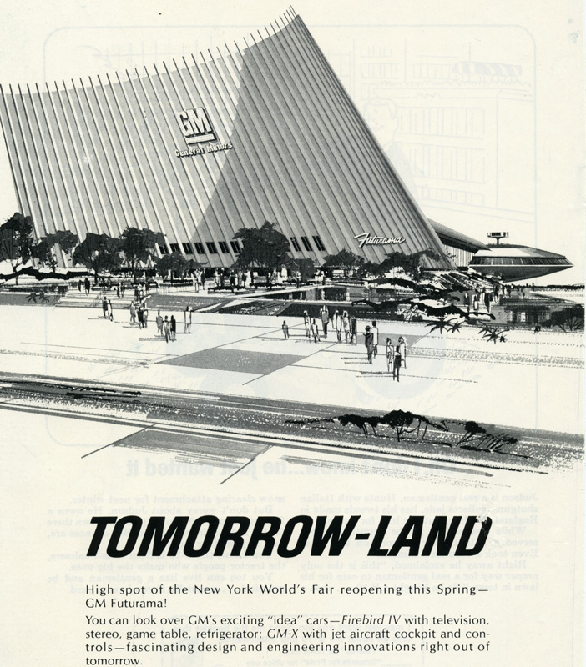
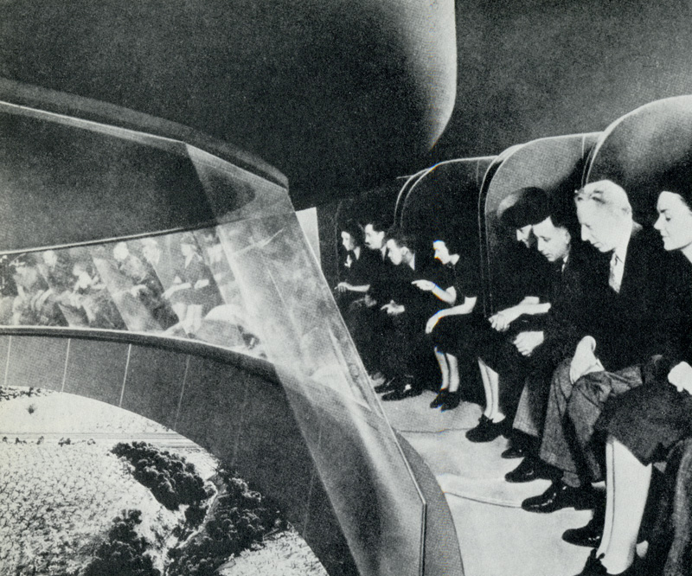
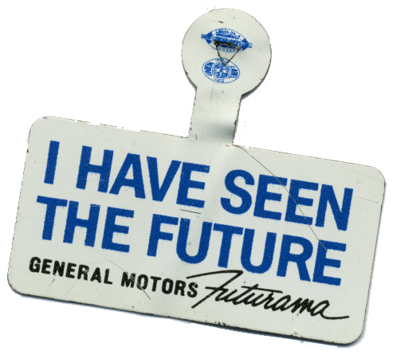
1964 World’s Fair Futurama
1939 World’s Fair Futurama

Slide 34
Resources
www.uscscenariolab.com
Bechky, B. A. (2011). Making organizational theory work: Institutions, occupations, and negotiated orders. Organization Science, 22(5), 1157-1167.
Bechky, B. A., & Okhuysen, G. A. (2011). Expecting the unexpected? How SWAT officers and film crews handle surprises. Academy of Management Journal, 54(2), 239-261.
Burke, K. (1984). Permanence and Change. University of California Press.
Forman, J. (2013). Story Telling in Business. Stanford University Press.
Weick, K. E., Sutcliffe, K. M., & Obstfeld, D. (2005). Organizing and the process of sensemaking. Organization Science, 16(4), 409-421.

